Slide 1

Mini Project Work-Phase 1 Review/22IDT28
Project Review Presentation (25 Mks) – CIE
____ July 2024, First Year (2nd Semester)
Dayananda Sagar College of Engineering, Bangalore, Karnataka
Department of Electronics & Communication Engineering
Section : N
Vayu: EMV
Mini Project Batch No : 6
USN : 1DS23EC010 (Sec-N) Name : ADITYA KAHALI
USN : 1DS23EC052 (Sec-N) Name : BHAVYA NAYAK
USN : 1DS23EC110 (Sec-N) Name : MALLADI ROHIT
USN : 1DS23EC122 (Sec-N) Name : MEGH KANTI
Section Coordinator
Prof. / Dr. PADMAVATHI M.
Mini Project Guide
Prof. / Dr. T. C. MANJUNATH

Slide 2

Vayu : EMV Economic Mobile ventilator

Slide 3
Overview of the mini project phase-1 (CIE-1) presentation
INTRODUCTION
LITERATURE SURVEY
SCOPE, PROBLEM STATEMENT AND OBJECTIVE
METHODOLOGY ADOPTED USING BLOCK-DIAGRAMS AND FLOWCHART
HARDWARE AND SOFTWARE TOOLS USED
IMPLEMENTATION PROCEDURE CARRIED OUT (HARDWARE AND SOFTWARE)
RESULTS (EXPERIMENTS AND SIMULATION)
ADVANTAGES
APPLICATIONS
CONCLUSIONS
OUTCOME OF THE PROJECT
FLOW OF THE FUTURE WORK
REFERENCE USED

Slide 4
INTRODUCTION (ABSTRACT)
If the respiratory parts of a living being collapse, the body is incapable of providing adequate oxygen to different body parts (namely brain, oxygen, heart, kidneys, etc.). This is capable of killing the living being instantly. The Ventilator comes into play in situations like this as it acts as an external respiratory system for the body, thereby protecting the being from sudden collapse.
Though Ventilator has proved itself to be extremely useful, it has its drawbacks. Its cons are as crucial as high cost, huge weight, and inadequate quantity, amongst many other factors. During crucial times of COVID-19, almost every nation saw an inadequate quantity of ventilators, which resulted in such high number of deaths across each nation. Even during warfare, irrespective of any front, the casualties are always unavoidable but sometimes there does exist a single point of chance to save a life. The same theory applies to victims of natural disasters as due to natural disasters; a high number of victims need assistance with their physical state.

Slide 5
INTRODUCTION (ABSTRACT)
Our device aims to be one of a kind as it aims to be portable so that in times of crucial times when ambulances and big medical assistance can’t be provided, this machine could be made readily available and easily transported to the patient, victim or soldier. It also aims to be cost efficient so that it could be affordable to the people and health related industries while also having the ability to be mass produced so that it can serve a larger population in such a way that if in coming days, if a pandemic hits, casualty rate won’t be this high as observed in the past. It also aims to be a machinery capable of doing ventilation work for the living being while monitoring heart rate in such a way that it would contact nearest hospital in case of a severe emergency, thus saving the patient.

Slide 6
LITERATURE SURVEY
BOOKS/PUBLICATION | WRITER | INSIGHT
Measurement of Respiratory Mechanics during Mechanical Ventilation | Giorgio A Lotte and A Braschi (1999) | It provides necessary information regarding automatic measurement of respiratory mechanics, and in general to exploit the potential of respiratory monitors at its best and maximum level
Clinical Application of Mechanical Ventilation | David W Chang (1997) | It provided the basic information regarding the application of ventilator
The Advanced Ventilator | William Owens (2017) | The different components of advanced ventilator which serves various purpose are written in this book.

Slide 7
SCOPE & PROBLEM STATEMENT
The already existing ventilator had multiple attempts of innovation on it but almost every organisation has either failed to make it affordable or working or both.
Growing population is a surety that there would be further need of much more ventilators along with more efficiency.
The scope of this project is that the ventilator made successfully would be able to have multiple functions like being portable, cost-efficient and should be able to do basic working of ventilator that is the exchange of air and acting as the lungs for the living beings.
The scope of the project is also to make this device more efficient as this machine would be able to have heart rate detector which would alarm if the heart fails and signal the nearest hospital for ambulance.

Slide 8
OBJECTIVE OF MINI PROJECT WORK
Our objective is to innovate a ventilator capable enough to save a living being while having the property of being portable such that it can be carried to sites of natural disasters, accidents, crimes or even during warfare to the frontlines, to prevent any mishappening to any of the victims, patient, or soldier all being done in a very economical figure while maintaining the same standards.
Its secondary objective stands at monitoring the heart rate of patient and in case of emergency, signalling a call of distress to nearest hospitals thereby doing everything in its capability to save a living being.

Slide 9
METHODOLOGY ADOPTED USING BLOCK DIAGRAM
The ventilator works on the principle of suction of air from the atmosphere using vacuum chamber and then delivering oxygen to patient through valve system which will help us segregate oxygen to the patient and exhaled carbon dioxide. And also making sure that the exhaled carbon dioxide is released from the body to protect the patient. The continuous action of providing oxygen and tsking away carbon dioxide creates a pressure in the respiratory system thereby making sure the cycle of breathing continues. Along with that the heart monitor would be monitoring the heart rate of the person. If by any case, a person gets into an emergency, the heart monitor would detect it and send a distress signal to the nearest hospital to protect the patient.

Slide 10
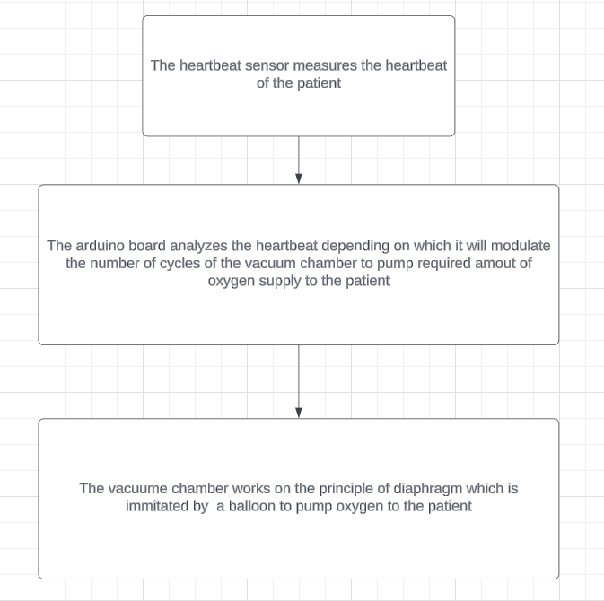
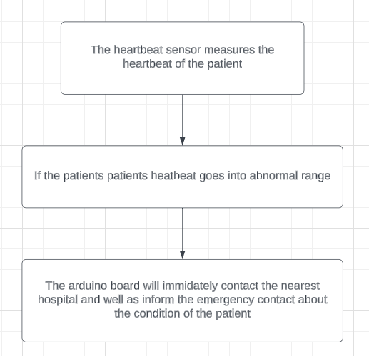
METHODOLOGY ADOPTED USING BLOCK DIAGRAM

Slide 11
HARDWARE AND SOFTWARE TOOLS USED IN THE PROJECT
SOFTWARE
HARDWARE
ARDUINO IDE
VISUAL STUDIO CODE
JHD 162A LCD
Arduino uno
Heartbeat sensor
IIC 12C Adapter
Jumpers
Hot Bag
Tubes

Slide 12
Implementation procedures carried out(Work done so far)
The first step of action was selecting through our machinery’s working and capabilities. Owing to the calculated capabilities of the device, we went through a selection of equipment required needed for ensuring smooth operation of the device.
The very next step was obtaining the materials through different markets.
Our next step was to integrate most of the equipment together and write the codes.

Slide 13
Results (experimentation or simulation)
The expected result of this working model of the device is that in case of an emergency where a patient is in urgent requirement of a device to keep the person from lung collapse, this device would be the required one.
The machine would have tubes inserted inside through endocranial tubes. The oxygen and carbon dioxide exchange would take place through a hot bag which would also in turn act as the pumping machine thereby acting as artificial lungs.
The heart detector would be detecting heart rate and in case of emergency lead out an emergency alarm to the nearest medical establishment for the emergency services.

Slide 14
APPLICATIONS
If a person suffers from any kind of vulnerable situations due to which even respiration can need large amount of energy, this machine breathes for that person thereby helping them in survival.
Continuous monitoring of heart rate of a person thereby helping in faster and more successful treatment.
During surgeries, there is a need of external breathing for a person as general anaesthesia makes it difficult for a person to breathe.
To prevent a person to get fluid in their lungs.
In case of brain damages, sometimes brain can’t communicate well with the lung for breathing well so in that case the ventilator needs to be used to make sure that the patient doesn’t collapse.

Slide 15
ADVANTAGES
Considering its portable characteristics, this machinery could be taken in places of conflict, where any natural disaster has stuck or places where crimes have happened.
Due to its portable nature, it could be transported well with patient easily without breaking any flow.
Due to heart monitoring and signal system, rapid action can take place so that the patient can be saved.
Because of its economic characteristics, it can be used in household for the patient rather than keeping the patient in hospital thereby protecting the family from burning a hole in their pocket.
Even due to its economic characteristics, it can be mass produced, thereby making sure that in case of a global pandemic, the government would be able to manage the assets better for everyone’s protection.
In case of natural disasters, and warfare, where times play one of the most crucial factors, this could be a real game changing innovation

Slide 16
Conclusions and future work of the mini-project work
With the advent of advanced system in medical electronics paired with that of advancing signal system, we all saw the miracles being done. One of them is a Ventilator.
Though our project aims to provide the machinery required for the exchange of gases within the living being along with the compatibility of providing the heart monitor, we are restricted because of our knowledge in creating a much more advanced version of the machinery which would not only be able to provide the bare minimum but provide us the optimum solution.
Thus the future scope of the project is that we achieve the efficiency that could compete with any world class ventilator and also be able to not just breathe for the being but fully heal the living being.

Slide 17
Outcome of the mini-project work
The expected outcome of this mini-project is a full-fledged working model of the visualized conceptualized ventilator and also to seek that the future innovation still holds with the already innovative machinery such that it still fosters growth in this society. We also expect the working model to completely smooth in operation such that the main objectives of the projects are achieved.

Slide 18
Flow of the mini-project works
April – Case Study, topic search, finalization, approval from guide
May - Starting of the mini-project work, study & implementation of the model, test run
June – Final implementation & mini-project demo with mini-project exhibition
July - SEE Exam

Slide 19
References Used
BOOKS | WRITER
BASIC PRINCIPLES OF MECHANICAL VENTILATION | MELODY BISHOP
MECHANICAL VENTILATION: PHYSIOLOGY AND PRACTICE | JOHN W KRIET
PRINCIPLES AND PRACTICE OF MECHANICAL VENTILATION | MARTIN J. TOBIN
MIT EMERGENCY VENTILATOR | DESIGN TOOLBOX

Slide 20



